Slide 1

NEO4J
License Source code: GPLv3 and AGPLv3
Binaries: Freemium registerware

Slide 2
Contents
What is Graph DB, where to use it.
Download and Install Neo4J.
CRUD operations in Neo4J.
Advanced Match.
Datatypes.
Case and Foreach.
Use neo4j with Spring Boot.
References.

Slide 3
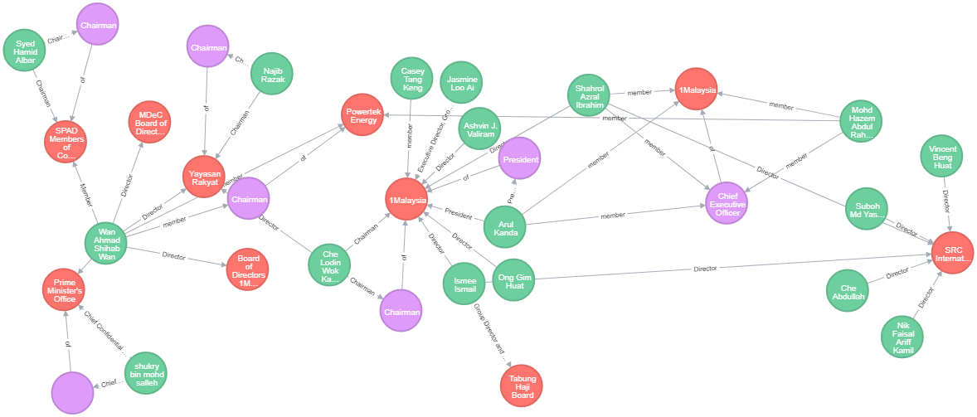
What is Graph DB
What is Graph Database?
Graph databases are NoSQL databases which use the graph data model comprised of vertices and edges, which represent the relationship between two nodes.

Slide 4
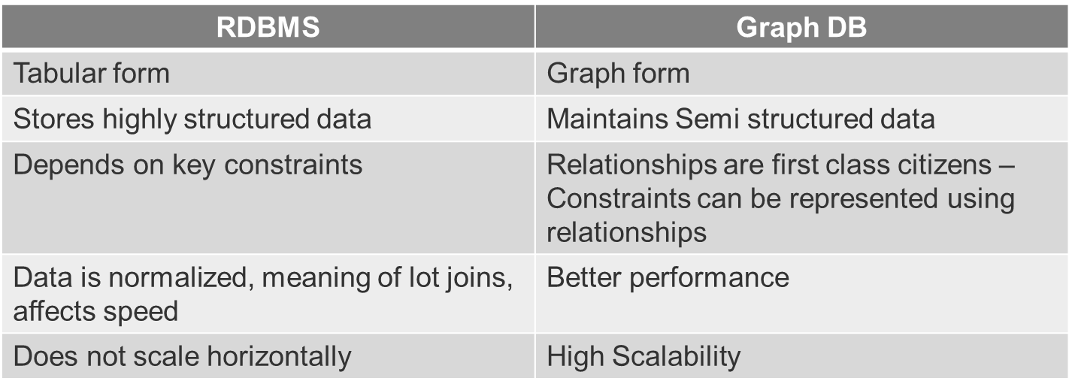
Why Graph DB
How is Graph Database different than Relational Database?
How is Graph Database different than Relational Database?
Graph databases are particularly well suited to storing connected data – data with lots of interconnected relationships, especially those that run many levels deep.

Slide 5




Where is Neo4J used
Real time use cases of Neo4J.
Social networking.
Real time recommendation systems.
Knowledge graph.
Network and IT operations

Slide 6
Installation and Setup
Download neo4J: https://neo4j.com/download/
Start neo4j: bin/neo4j start.
Start neo4j as Windows service: bin/neo4j install-service

Slide 7
Basic Operations in Neo4J and understanding nodes
What is a node?
The vertices in the Graph DB, with list of properties.
Relationships between node?
Edges in Graph which connect each vertices.
Operations:
Create node.
Syntax: Create (variable_name: Label_name {Propertyname:Value})
Match node.
Syntax: Match (variable_name: Label_name) return variable_name
Create Relationships.
Syntax: Create (name1: Node)-[:relationship]->(name2:Node)

Slide 8
Basic Operations Continued…
Match with field values – Conditional Statement.
Syntax: Match (n1:node) where n1.field=[value].
Delete nodes.
Syntax: Match (n1:node) delete n1
Delete Relationships.
Syntax: Match (n1:node)-[rel]->(n2:node) delete rel
Update field values.
Syntax: Match (n1:node) set n1.newfield
Add/remove fields.
Syntax: Match (n1:node) remove/set n1.newfield=[value]

Slide 9
Basic Operations Continued…
Using Optional.
Syntax: Match (n1:node) Optional Match (n1)-[rel]-(n2:node) return *
Using “WITH”
Syntax: WITH [1,2,3,4] as res return res[2]
Working with Nulls.
Syntax: With (true or NULL) as res return res
Merge
On Create
On Match
Syntax: Merge (n:node) On Create n.created=true

Slide 10
Advanced Match queries and Datatypes
Regular expression
Syntax: Match (n:node) where n.name=~ ‘(?i)val.*’
Working with paths
Shortest path
Property types
Number
String
Boolean
Composite types
List
[1,2,’Three’]
Map
return {Key: ‘Value’}

Slide 11
Advanced Match queries and Datatypes
List comprehension
return [x in range(0,10) where x%2==0|x^2] as result
Map Projections
match (g:Guy)-[:SEEN]->(m:Movie) return g{.name, .age, movies: collect(m {.name,.released})}
Using “CASE .. WHEN”
Syntax: match (m:Movie) return m.name, CASE WHEN m.released>1993 Then true Else false end as BoolValue.
CASE test
WHEN value THEN result
[WHEN ...]
[ELSE default]
END
Using Foreach
match (m:Movie) with m,collect(m.name) as names
foreach (n in names | set m.mill=‘ ‘)

Slide 12
Integration with Spring Boot
Setting up development environment for SpringBoot + Neo4J
Configurations related to OGM (Object Graph Mapping).
Creating nodes and Relationships.
Retrieving nodes from database
Refer: https://www.baeldung.com/spring-data-neo4j-intro

Slide 13
References and Course Content
https://neo4j.com/developer/get-started/
https://neo4j.com/resources/
https://neo4j.com/developer/resources/
https://neo4j.com/docs/cypher-manual/3.5/
https://spring.io/projects/spring-data-neo4j

